Slide 1




Exploratory Data Analysis Use Case Presentation
Retail Analytics – Sales Analysis on Windows

Slide 2
Understanding the Dataset
Notes:
When conducting research, it is easy to go to one source: Wikipedia. However, you need to include a variety of sources in your research. Consider the following sources:
Who can I interview to get more information on the topic?
Is the topic current and will it be relevant to my audience?
What articles, blogs, and magazines may have something related to my topic?
Is there a YouTube video on the topic? If so, what is it about?
What images can I find related to the topic?

Slide 3
Understanding the Dataset
Month | Enquiry Date | Enquiry Id | Allocation Status | Status | State | City | Pincode | Type of Project | No of Windows
April'16 | 02-Apr-16 | EC02041646800 | Dealer | Won | TAMILNADU | CHENNAI | 600008 | Renovation | 6 to 10
April'16 | 08-Apr-16 | EC08041647157 | Dealer | Lost | TAMILNADU | CHENNAI | 600042 | New Construction | 6 to 10
Source | Zone | Dealer Name | First Action-Call made | Date DD/MM/YY | First Action-Call Status | Date of Appointment (DD/MM/YY) | Second Action-Customer Meeting | Date DD/MM/YY | Second Action-Call Status
Friends or Family | Chennai | Sunbird | Yes | 02-Apr-16 | Appointment Fixed | 04-Apr-16 | yes | 05-Apr-16 | Quote to Be Submitted
Just dial | Chennai | Winfratech | Yes | 08-Apr-16 | Appointment Fixed | 09-Apr-16 | yes | 10-Apr-16 | Further Meeting Required
Third Action-Quote Given | Date DD/MM/YY | Q Val. (Rs. Lac) | Quote QTY | Order Recd\Lost | Date DD/MM/YY | Order Val. (Rs. Lac) | Order QTY | Quote ID (as per match to CCC Records) | Remarks-Brand and value if lost to UPVC | Second Action-Call Status | Remarks | Price Per Sft
yes | 06-Apr-16 | 0.72 | 3 | Order Received | 19-Aug-16 | 0.54 | 3 | SPN58634 | won |  |  | 1105
 |  |  |  | Lost to Aluminum |  |  |  |  | Budget constraint |  | Price Issue | 985
Benefits | Aesthetics | Reduce Street Noise | Low Maintenance | Monsoon Proof | Better Lighting | Reduce AC Energy Cost
Aesthetics & Street Noise | 1 | 1 | y | 0 | 0 | 0

Slide 4
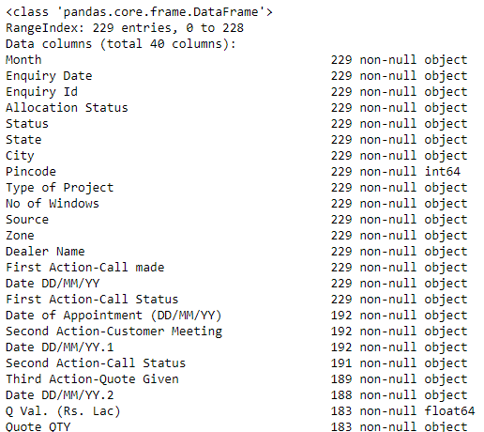
Understanding the Dataset
1
Python Code :
2
data.info()
Data Inconsistency
No. of Rows = 229
No. of Columns = 40

Slide 5
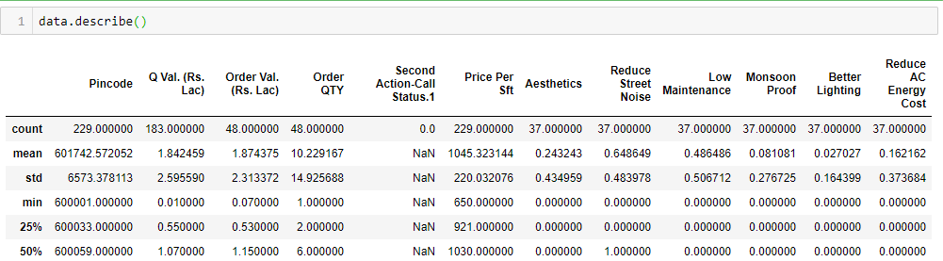
Data Cleaning
1
Data Type Conversion:
data['Pincode'] = data['Pincode'].astype(object)
data['Enquiry Date'] = pd.to_datetime(data['Enquiry Date'])

Slide 6
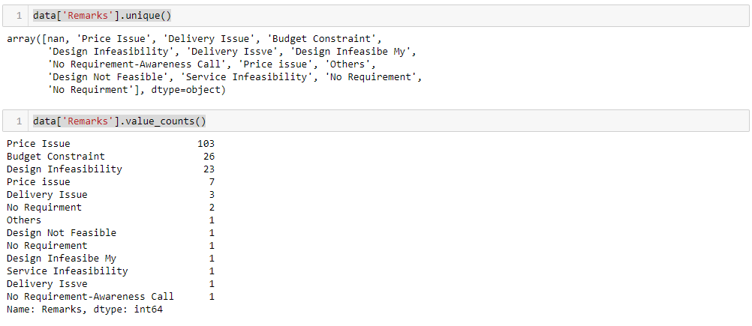
Data Cleaning
2
Data Inconsistency:

Slide 7
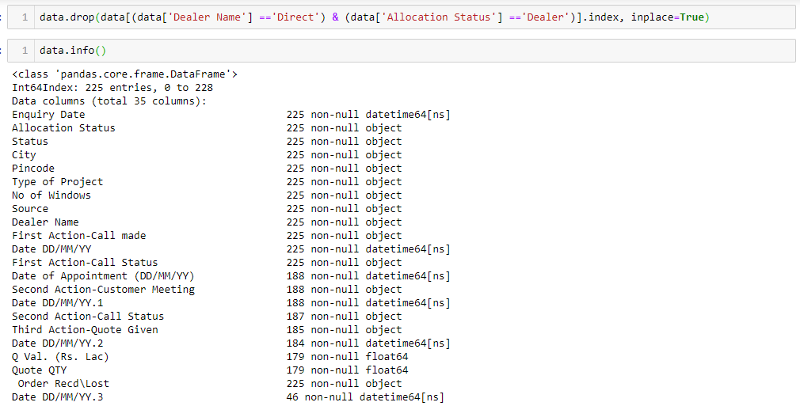
Data Cleaning
3
Deleting unnecessary rows and columns:

Slide 8
Finding the Insights
Notes:
Now, that you have narrowed your topic, you will want to organize your research in a structure that works. There are some common organizational patterns based on the kind of research you are doing.
Organizational Structures:
Cause and Effect- this kind of structure is great for explaining the causes and effects of a topic
Compare and Contrast- in this pattern you highlight the similarities and differences of the topic
Explain process- this structure is great for outlining a series of steps to follow;
Definition- if you want to make sure your audience understands what something is using illustrations, meanings, clarifying misconceptions, you may want to use this structure
Classification- a common organizational structure is grouping like topics or facts from the research together. For instance, in the internet safety about social media apps, you may organize the research where you look at each social media app one at a time

Slide 9
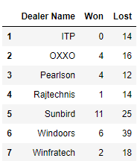
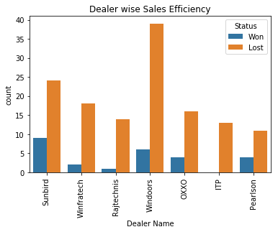
Performing and Non-Performing Dealers
1

Slide 10
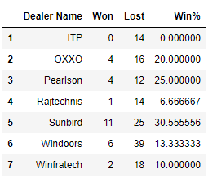
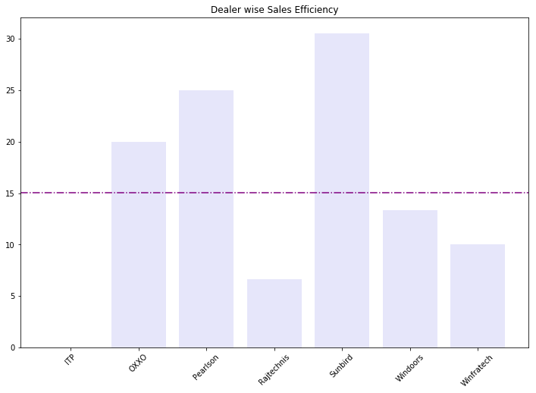
Performing and Non-Performing Dealers
2

Slide 11
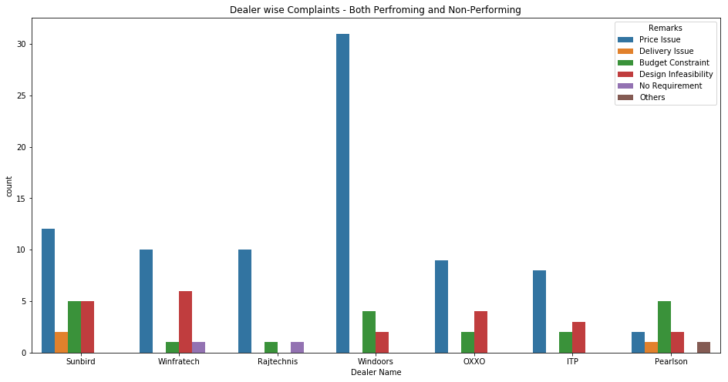
Why they are not performing well?
1
With the help of remarks & dealer name we found the area where the dealer is not performing well, price issue is evident in each Dealer.

Slide 12
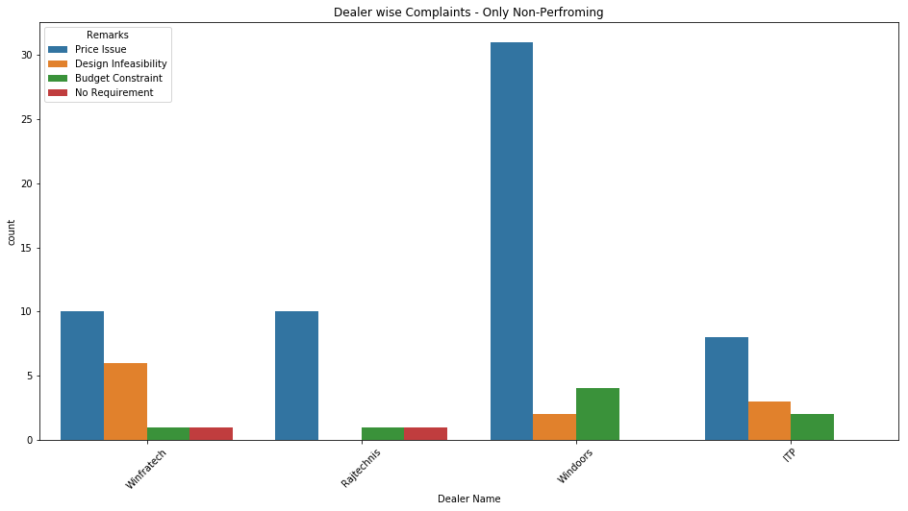
Why they are not performing well?
2

Slide 13
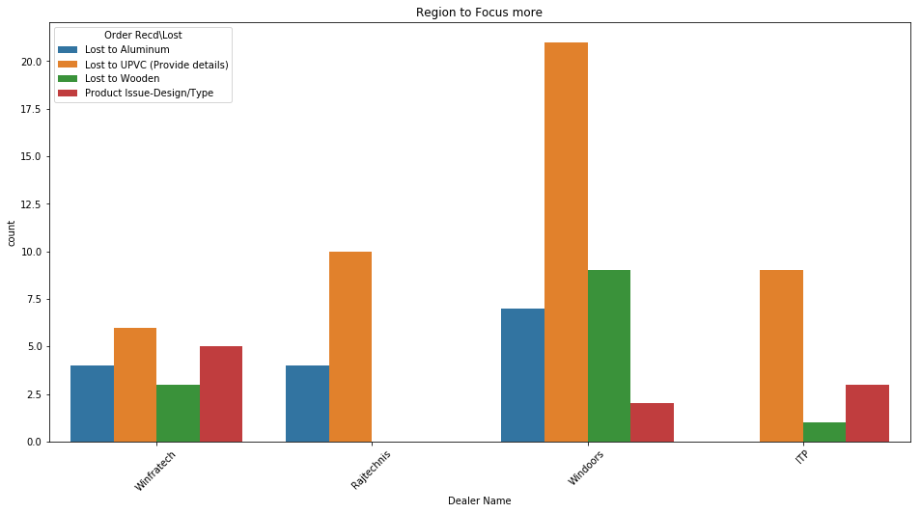
Region to focus more
3

Slide 14
Discount Insights
4
Dealer Name | Date DD/MM/YY | Q Val. (Rs. Lac) | Quote QTY | Date DD/MM/YY | Order Val. (Rs. Lac) | Order QTY | Gap | Discount Given
OXXO | 25-Apr-16 | 5.23 | 45 | 02-Jun-16 | 5.23 | 45 | 38 | 0
OXXO | 23-Jun-16 | 0.4 | 1 | 23-Jun-16 | 0.39 | 1 | 0 | 1
OXXO | 29-Nov-16 | 0.54 | 2 | 06-Dec-16 | 1.09 | 6 | 7 | 8.833333333
Pearlson | 22-Aug-16 | 10.95 | 13 | 28-Sep-16 | 10.95 | 13 | 37 | 0
pearlson | 21-Nov-16 | 1.28 | 8 | 23-Nov-16 | 1.28 | 8 | 2 | 0
Rajtechnis | 29-Aug-16 | 1 | 4 | 27-Sep-16 | 0.53 | 4 | 29 | 11.75
Sunbird | 06-Apr-16 | 0.72 | 3 | 19-Aug-16 | 0.54 | 3 | 135 | 6
Sunbird | 15-Apr-16 | 1.63 | 8 | 21-May-16 | 1.63 | 8 | 36 | 0
Sunbird | 23-Apr-16 | 5.5 | 4 | 12-Jul-16 | 3.85 | 5 | 80 | 60.5
Sunbird | 24-Apr-16 | 1.64 | 3 | 29-Aug-16 | 0.88 | 7 | 127 | 42.0952381
Sunbird | 23-Jun-16 | 1.22 | 3 | 25-Jul-16 | 1.22 | 3 | 32 | 0
Sunbird | 10-Sep-16 | 1.97 | 3 | 21-Sep-16 | 1.48 | 4 | 11 | 28.66666667
Sunbird | 01-Aug-16 | 1 | 0.6 | 25-Aug-16 | 0.86 | 1 | 24 | 80.66666667
Sunbird | 06-Jan-17 | 0.37 | 1 | 12-Jan-17 | 0.2 | 1 | 6 | 17
Sunbird | 19-Jan-17 | 0.2 | 1 | 25-Jan-17 | 0.2 | 1 | 6 | 0
Windoors | 16-Nov-16 | 1.55 | 10 | 21-Jan-17 | 1.53 | 9 | 66 | -1.5
Windoors | 08-Nov-16 | 10 | 39 | 17-Nov-16 | 7.05 | 41 | 9 | 8.44590369
Windoors | 21-Dec-16 | 0.01 | 1 | 27-Dec-16 | 0.07 | 1 | 6 | -6
Windoors | 30-Jan-16 | 2.89 | 12 | 12-Jan-17 | 2.89 | 12 | 348 | 0
Winfratech | 25-Apr-16 | 1.5 | 7 | 06-Oct-16 | 1.5 | 7 | 164 | 0
Winfratech | 11-Aug-16 | 0.21 | 1 | 16-Aug-16 | 0.61 | 1 | 5 | -40
If the Time gap between the Quote and Order is more than the Dealer is liable to provide more discounts

Slide 15
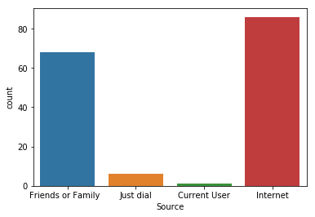
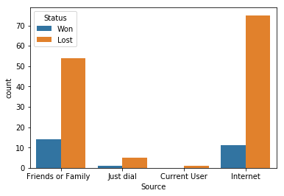
Sales Referral Insights
5

Slide 16
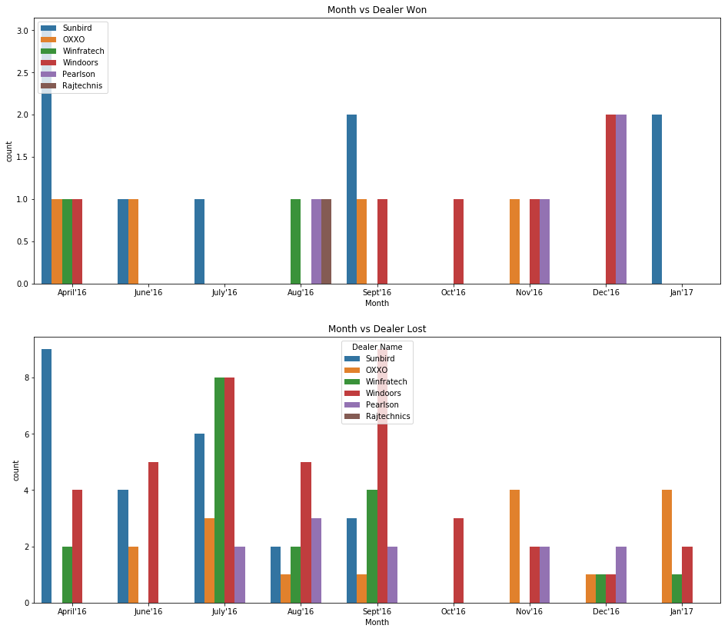
Monthly Insights
6

Slide 17
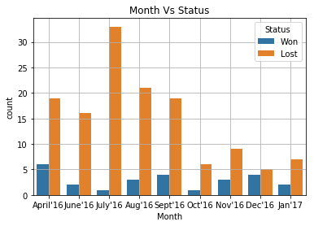
Monthly Insights
6
# July has more number of enquiries and more lost deals

Slide 18
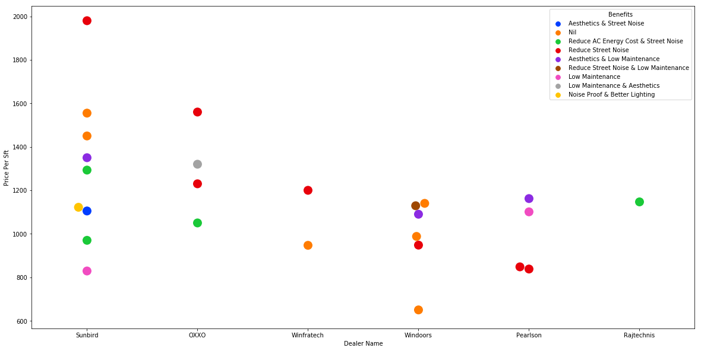
Benefits Insights
7
# Above plot gives me an idea of which dealer is providing a particular benefit for best price

Slide 19
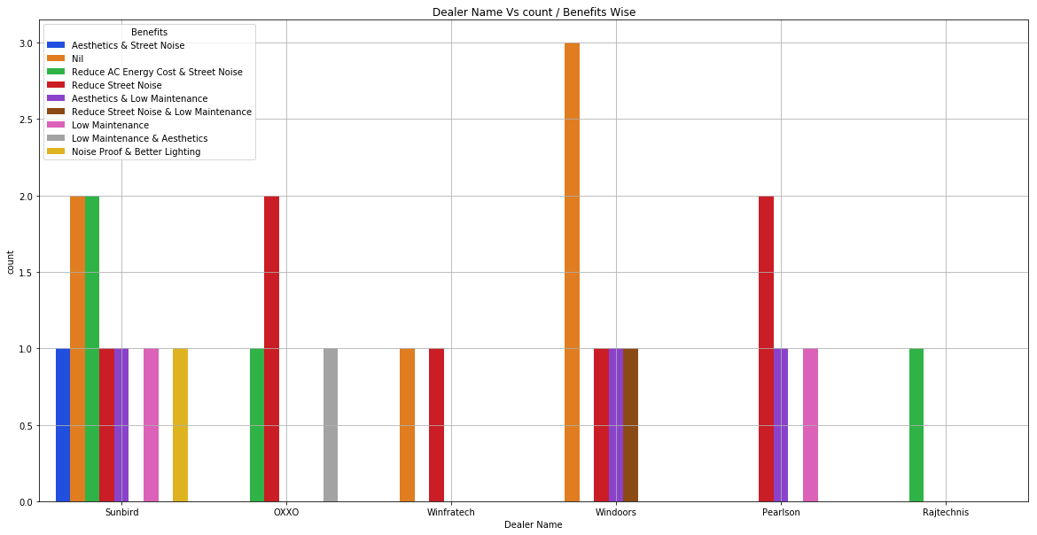
Benefits Insights
7
#Benefits variety count of company:
Sunbird - 6, Oxxo - 3, Winfratech - 2, Windoors - 3, Pearlson - 3, Rajtechnis - 1

Slide 20
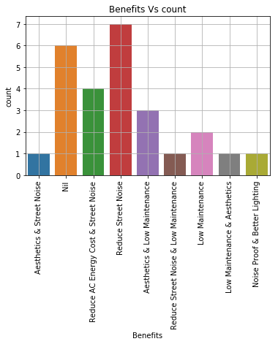
Benefits Insights
7
# Benefits with more count:
1)Reduce Street Noise – 7
2)Reduce AC Energy Cost & Street Noise – 4
3) Aesthetics & Low Maintenance – 3
4)Low Maintenance- 2
5)Reduce Street Noise & Low Maintenance,
Low Maintenance & Aesthetics,
Noise Proof & Better Lighting - 1

Slide 21
Recommendation & Conclusions
Notes:
After you’ve done your research, it’s time to put your presentation together. The first step in the process is to introduce the topic. This is a great time to connect your topic to something that your audience can relate. In other words, why should they listen to all the information you will be sharing in your research presentation? What is in it for them? You may also want to include a graphic or image to grab their attention.
Feel free to duplicate this slide by right-clicking on this slide in the slides pane to the left and select Duplicate Slide.
The next step in your presentation is to state your claim or topic clearly. Your teacher may even call this your thesis. As you state your thesis, you may find that this layout is not the best layout for your claim or topic. You can change the layout by clicking the drop-down menu next to the Layout in the Slides menu section. You can choose Two Content, Comparison, or Picture with Caption. Note: A different layout might change the look of the icons on this page.
You will also want to state your facts. You have done the research now share some of the interesting facts with your audience. Facts do not have to be boring; you can communicate facts in a variety of ways by going to the Insert Tab. In the Insert tab you can:
Insert pictures from your computer or online.
Add a chart
Create some SmartArt
Insert a variety of icons to help your facts come to life. Note: You can change the color of the icons by selecting the icon and then click on the Format tab and then Graphics Fill. From there, you will choose a color from the list or choose More Fill Colors to give you more options.
Since this research presentation is a result of your hard work and searching, you want to make sure you support the claims or points in your presentation with facts from your research findings. Make sure you give the author proper credit for helping you share your ideas. If one of your sources has a video that is relevant to your topic, you can add the video as added support. Keep in mind the length of the video and the amount of time you have for your presentation. For a 5 minute speech, the video should be no longer than 30 seconds.
Questions to consider:
How will you state the author of the source?
Will you need to cite the source on the slide?
What are some ways you can engage your audience so they feel like they are a part of the presentation? Some ideas to consider is by taking a quick poll like: by a show of hands, how many of you think school uniforms are a way to cut down on bullying? Another suggestion is to have them hold up a certain number of fingers to see if they agree or disagree. Finally, you can share a story that the audience can relate to that makes them laugh.
After all the applause, your audience may have some questions. Be prepared to answer some of their questions by making a list of questions you think they might ask. You may also want to share the presentation with them by providing the link to your presentation, if they want more information.

Slide 22
Recommendations:
With reference to ‘Remarks’, we suggest dealers to re-evaluate the pricing of product.
Dealer ‘Windoors’ should improve the product in competence with UPVC as he is losing more deals.
Though Sunbird’s performance efficiency is good, better planning of installation time could increase revenue being lost in the form of discount.
Dealers should focus on trending web marketing than conventional marketing.
Customised Added value benefits can provide customer freedom of choice and improves the additional revenue.

